Slide 1
Introduction to JavaScript
CPRG256

Slide 2
Introduction
What is JavaScript?
It is a scripting language
It runs inside other programs, like browsers, which provide a JavaScript interpreter
It is often used to add special effects and data validation to HTML web pages
JavaScript is not Java!
The name was chosen to ride the Java hype at the time
Officially called ECMAScript
European Computer Manufacturers Association Script

Slide 3
What can JavaScript do?
Addition of code to HTML web pages, to:
Dynamically add/change the page's HTML text
React to events in the page
e.g. clicking on a button
Read and write HTML elements
Validate data
e.g. before submitting a form to a server
Determine the type of browser being used to access a web site
Create and manage cookies (state information)
We'll talk a bit about these later in the course

Slide 4
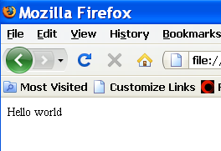
Adding JavaScript to an HTML page
We use the <script> tag, e.g.:
<html>
<head>
<script type="text/javascript">
document.write("Hello world");
</script>
</head>
<body>
</body>
</html>

Slide 5
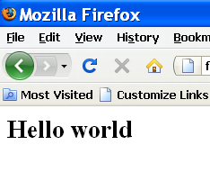
Adding JavaScript to an HTML page
Example: Changing HTML elements in a page
<html>
<head>
<script type="text/javascript">
document.write("<h1>Hello world</h1>");
</script>
</head>
<body>
</body>
</html>

Slide 6
Adding JavaScript to an HTML page
We can also put commonly-used JavaScript code in separate files, and link them into any web pages that need to used them, e.g.:
<head>
<script type="text/javascript" src="myJSfile.js"></script>
</head>
Typically such files end with .js
The file must not itself contain the <script> tag!

Slide 7
Variables in JavaScript
Much of what you learned about programming in Java also applies to JavaScript
But not everything!
JavaScript is also case sensitive (unlike HTML)
We can use variables and constants to store data values
BUT: JavaScript does not use data types like int, float, etc., unlike Java!!
It is "weakly typed"

Slide 8
Variables in JavaScript
Example: Difference in declaring a variable in Java and JavaScript
In Java: int x=0;
In JavaScript: var x=0;
JavaScript will figure out what type of value x should be able to store when we assign a value to it, e.g.
var x; //variable declaration
x=3; //x is made into an integer
x=3.14; //x is changed to be a float
x="apple"; //x is changed to be a string

Slide 9
Variable Names in JavaScript
Are case sensitive
X is a different variable to x
Must start with a letter or underscore, e.g.
_x, a, apple, x1 are all valid
1x, $x are invalid

Slide 10
JavaScript Expressions
An expression is a computation we want the program to do, e.g.
1+1
x=x+1
Expressions are composed using
Operators, e.g. +, -, * etc.
Operands: data values used by operators

Slide 11
JavaScript Expressions
JavaScript, like Java, has different types of operators, including:
Mathematical: +, -, *, /, %, ++, --
Assignment: =, +=, -=, *=, /=, %=
Comparison: ==, ===, !=, >, <, <=, >=
Logical: && (and) , || (or) , ! (not)
Conditional: ?:
Most of these operators work in the same way as they do in Java

Slide 12
if statements
Conditional logic can be constructed using the if statement, e.g.:
var x=1;
if (x==1) alert("x is one");
We can also create else clauses, e.g.
var x=1;
if (x==1)
alert("x is one");
else
alert("x is not one");

Slide 13
if statements
And we can create if..else chains of logic, e.g.
var x=2;
if (x==1)
alert("x is one");
else if (x==2)
alert("x is two");
else if (x==3)
alert("x is three");
else
alert("x is something else…");

Slide 14
switch statements
Used to "clean up" long if..else chains where we are testing the same variable for multiple different possible values, e.g.
var x=2;
switch(x)
{
case 1: alert("x is one");
break;
case 2: alert("x is two");
break;
case 3: alert("x is three");
break;
default:
alert("x is something else…");
}

Slide 15
JavaScript looping constructs
JavaScript supports all the usual loop types:
while
do..while
for
They work the same way as they do in Java
All contain the three parts required by any loop:
Initialization
Test/Condition
Update

Slide 16

while loop
Example: show the numbers between 1 and 10 on the web page
var x=1; //init.
while (x<=10) //test
{
document.write(x + "<br>");
x++; //update
}

Slide 17
do..while loop
Example: same as last
var x=1; //init.
do
{
document.write(x + "<br>");
x++; //update
} while (x<=10); //test

Slide 18
for loop
Example: same as last
var x;
for (x=1; x<=10; x++)
document.write(x + "<br>");

Slide 19
How JavaScript sees web pages
The document in document.write is an object that the browser makes available to JavaScript
document.write means "write the text to the document representing the web page itself"
It contains other objects, representing the various elements, e.g. forms and controls, on the page
To access the value of an element, we start with the document object, and then reference the other element(s) in it

Slide 20
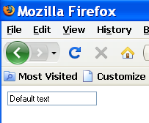
How JavaScript sees web pages
Example: a control in a form in a web page
<html>
<head>
</head>
<body>
<form name="myform">
<input type="text" id="mytext" value="Default text">
</form>
</body>
</html>

Slide 21
How JavaScript sees web pages
To access the value of the mytext textbox in the myform form on the web page we would use:
document.myform.mytext.value
We can get or set this value
The alert function shows a message box containing the text we specify, e.g.
alert(document.myform.mytext.value);
Or
alert(document.getElementById(“mytext”).value);

Slide 22
Using ‘id’ in page elements
Input fields e.g. text, number etc can be identified with unique ID values
<input type=“text” size=“25” id=“username”>
Javascript can then capture the input use ‘getElementById’
var user = document.getElementById(“username”).value;

Slide 23
JavaScript functions
We have already seen an example of a function in JavaScript:
function showValue()
{
alert(document.getElementById(“mytext”).value);
}
This function is called using showValue();
We can also give values to, and receive results back from, JavaScript functions

Slide 24
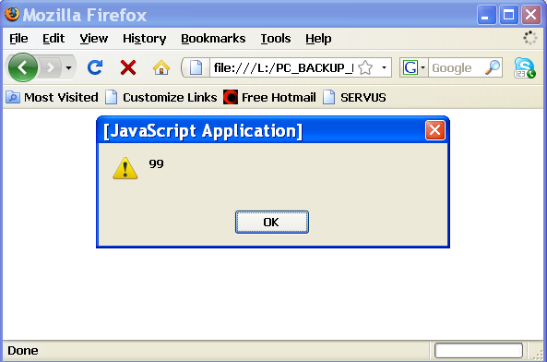
JavaScript functions
We give a function values to use when running by passing them as parameters/arguments to the function when it is called, e.g.:
<html>
<head>
<script type="text/javascript">
function showValue(theValue)
{
alert(theValue);
}
</script>
</head>
<body>
</body>
<script type="text/javascript">
showValue(99);
</script>
</html>

Slide 25
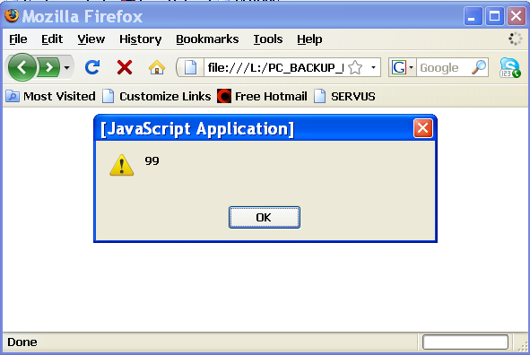
JavaScript functions
We can also use the return keyword to give back a result from a function:
<html>
<head>
<script type="text/javascript">
function returnValue()
{
return 99;
}
</script>
</head>
<body>
</body>
<script type="text/javascript">
alert(returnValue());
</script>
</html>

Slide 26
JavaScript functions
We can declare variables inside functions
These are called local variables
They exist only for as long as the function they are declared in is running, then they are destroyed and their contents lost
We describe the time that the variable exists in memory as it's lifetime, and the places in the program where it can be used as it's scope

Slide 27
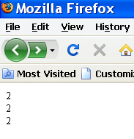
Local Variables in functions
Example: declaring a local variable in a JavaScript function
<html>
<head>
<script type="text/javascript">
function returnValue()
{
var x=1;
x++; //increment x to 2
return x;
}
</script>
</head>
<body>
</body>
<script type="text/javascript">
document.write (returnValue() +"<br>");
document.write (returnValue() +"<br>");
document.write (returnValue() +"<br>");
</script>
</html>

Slide 28
Event Handling with JavaScript
So far the browser has automatically been running JavaScript code when the page it is in loads
There are other reasons to run code
The user interacts with the page in some way, e.g. clicking on a button, rolls the mouse pointer over a control and we want it to be highlighted, etc.
The user wants to submit data in a form back to the server, and we need the browser to validate the data first
We describe things that happen that we want to run code for as "events"
We associate code with an event, so when the event happens the browser knows to run the code

Slide 29
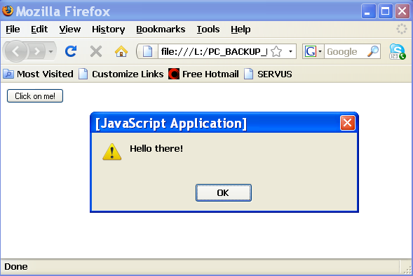
Event Handling with JavaScript
Example: running a function when a button is clicked on
<html>
<head>
<script type="text/javascript">
function hello()
{
alert ("Hello there!");
}
</script>
</head>
<body>
<form name="myform">
<input type="button" value="Click on me!" onClick="hello();">
</form>
</body>
</html>

Slide 30
JavaScript Examples
Refer to examples on the Brightspace site.

